Slide 1
Bipolar Junction Transistor (BJT)

Slide 2
Introduction
The basic of electronic system nowadays is
semiconductor device.
The famous and commonly use of this device is BJTs
(Bipolar Junction Transistors).
It can be use as amplifier and logic switches.
BJT consists of three terminal:
  → collector : C
  → base : B
  →emitter : E
Two types of BJT : pnp and npn

Slide 3
Transistor Construction
3 layer semiconductor device consisting:
  2 n- and 1 p-type layers of material → npn transistor
  2 p- and 1 n-type layers of material →pnp transistor
The term bipolar reflects the fact that holes and electrons participate in the injection process into the oppositely polarized material
A single pn junction has two different types of bias:
  forward bias
  reverse bias
Thus, a two-pn-junction device has four types of bias.

Slide 4
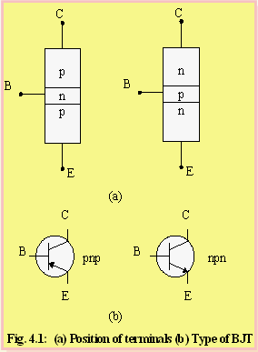
Position of the terminals and symbol of BJT.
Base is located at the middle
and more thin from the level
of collector and emitter
The emitter and collector
terminals are made of the
same type of semiconductor
material, while the base of the
other type of material

Slide 5
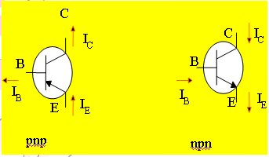
Transistor currents
The arrow is always drawn
on the emitter
The arrow always point
toward the n-type
The arrow indicates the
direction of the emitter
current:
    pnp:E→ B
    npn: B→ E
I_{C}=the collector current
I_{B}= the base current
I_{E}= the emitter current

Slide 6
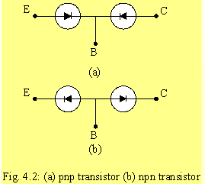
By imaging the analogy of diode, transistor can be
construct like two diodes that connetecd together.
It can be conclude that the work of transistor is base on
work of diode.

Slide 7
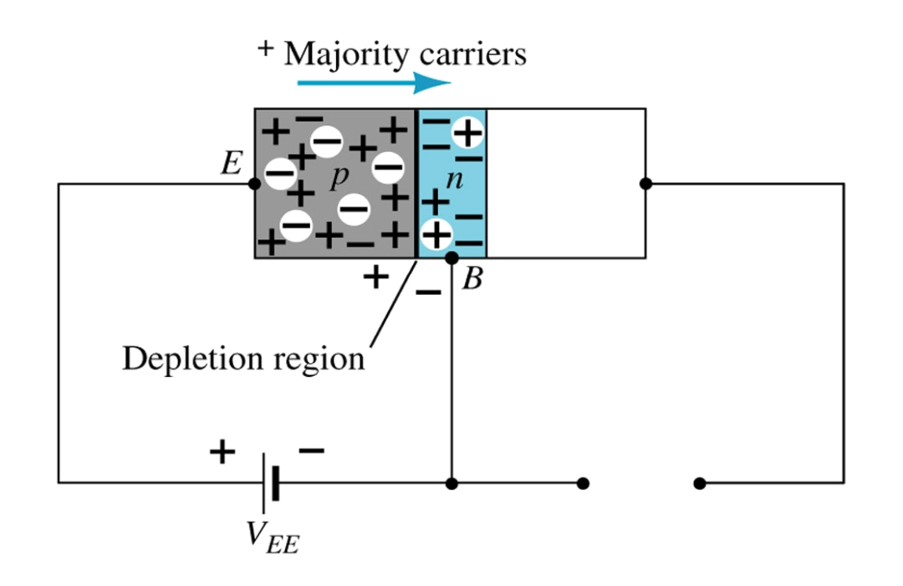
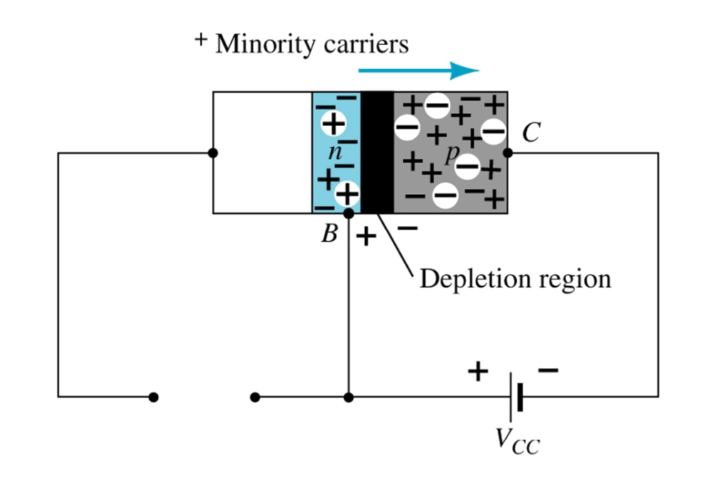
Transistor Operation
The basic operation will be described using the pnp transistor. The operation of the pnp transistor is exactly the same if the roles played by the electron and hole are interchanged.
One p-n junction of a transistor is reverse-biased, whereas the other is forward-biased.
Forward-biased junction
of a pnp transistor
Reverse-biased junction
of a pnp transistor

Slide 8
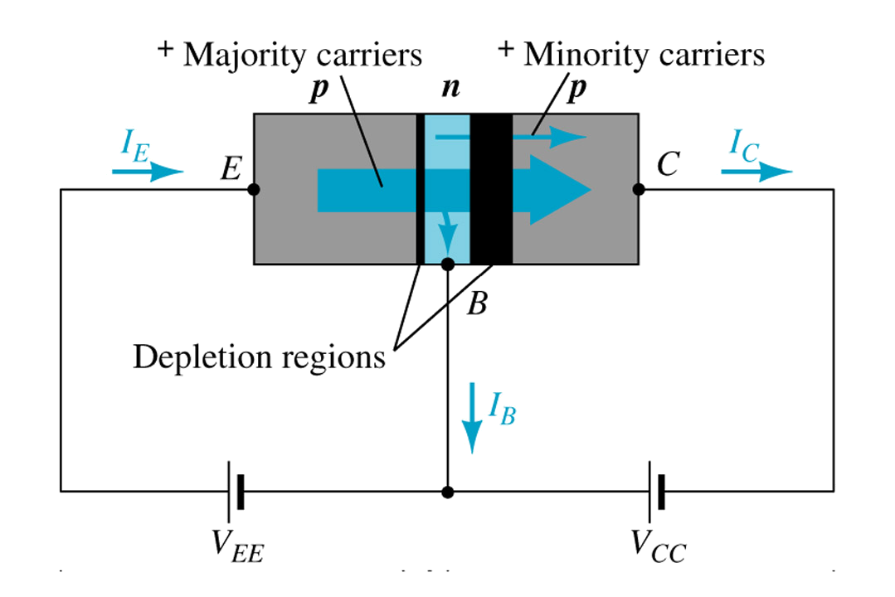
Both biasing potentials have been applied to a pnp transistor and resulting majority and minority carrier flows indicated.
Majority carriers (+) will diffuse across the forward-biased p-n junction into the n-type material.
A very small number of carriers (+) will through n-type material to the base terminal. Resulting IB is typically in order of microamperes.
The large number of majority carriers will diffuse across the reverse-biased junction into the p-type material connected to the collector terminal.

Slide 9
Majority carriers can cross the reverse-biased junction because the injected majority carriers will appear as minority carriers in the n-type material.
Applying KCL to the transistor :
I_{E} = I_{C} + I_{B}
The comprises of two components – the majority and minority carriers
I_{C} = I_{Cmajority} + I_{COminority}
I_{CO} – I_{C} current with emitter terminal open and is called leakage current.

Slide 10
Common-Base Configuration
Common-base terminology is derived from the fact that the :
- base is common to both input and output of the configuration.
- base is usually the terminal closest to or at ground potential.
All current directions will refer to conventional (hole) flow and the arrows in all electronic symbols have a direction defined by this convention.
Note that the applied biasing (voltage sources) are such as to establish current in the direction indicated for each branch.

Slide 11
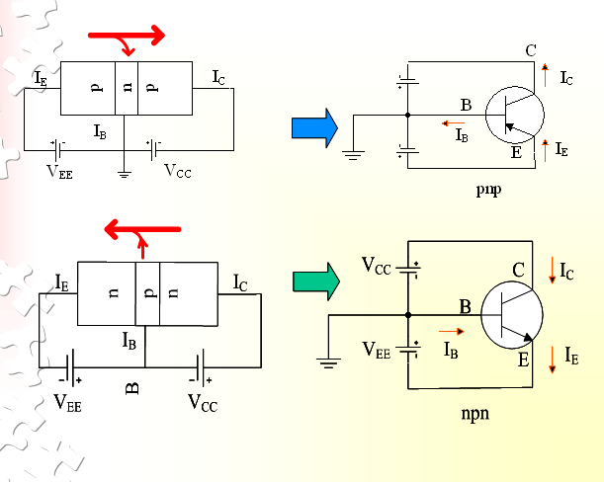

Slide 12
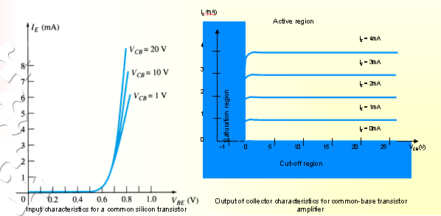
To describe the behavior of common-base amplifiers requires two set of characteristics:
  Input or driving point characteristics.
  Output or collector characteristics
The output characteristics has 3 basic regions:
  Active region –defined by the biasing arrangements
  Cutoff region – region where the collector current is 0A
  Saturation region- region of the characteristics to the left of V_{CB} = 0V

Slide 13
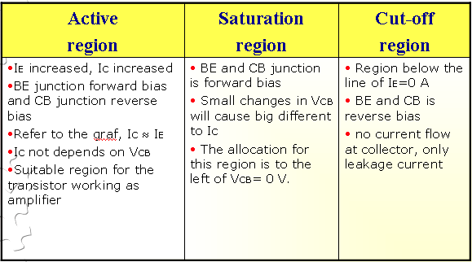

Slide 14
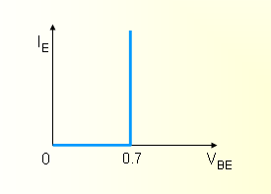
The curves (output characteristics) clearly indicate that a first approximation to the relationship between IE and IC in the active region is given by
I_{C} ≈IE
Once a transistor is in the ‘on’ state, the base-emitter voltage will be assumed to be
V_{BE} = 0.7V

Slide 15
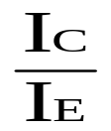
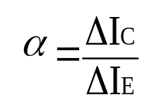
In the dc mode the level of I_{C} and I_{E} due to the majority carriers are related by a quantity called alpha
α=
I_{C} = αI_{E} + I_{CBO}
It can then be summarize to I_{C} = αI_{E} (ignore I_{CBO} due to small value)
For ac situations where the point of operation moves on the characteristics curve, an ac alpha defined by
Alpha a common base current gain factor that shows the efficiency by calculating the current percent from current flow from emitter to collector.The value of α is typical from 0.9 ~ 0.998.

Slide 16
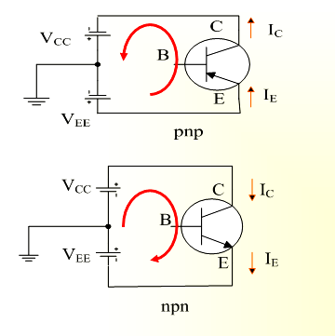
Biasing
Proper biasing CB configuration in active region by
approximation I_{C} ≈ I_{E} (I_{B} ≈ 0 uA)

Slide 17
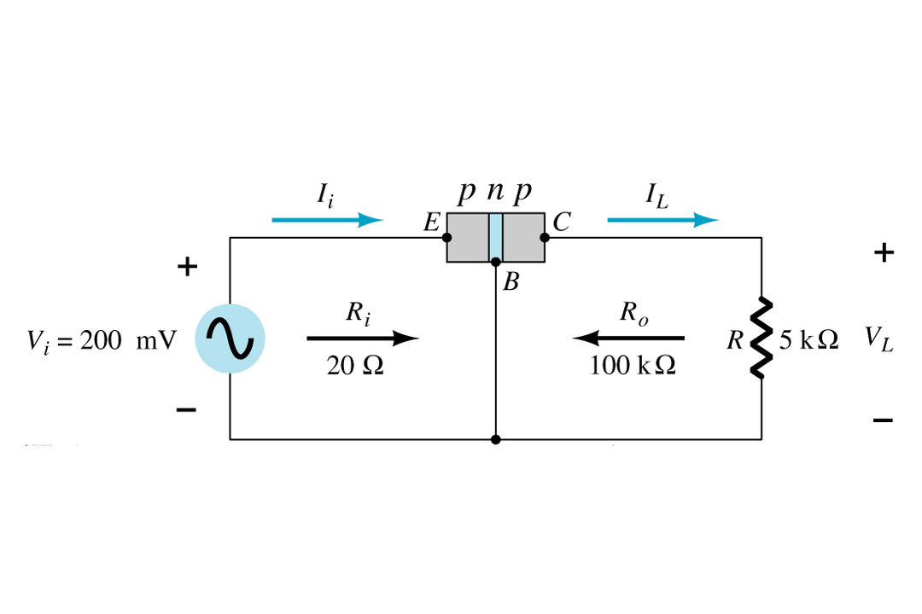
Transistor as an amplifier

Slide 18
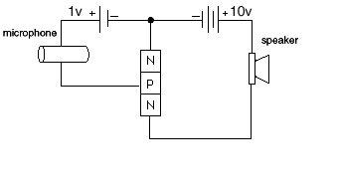
Simulation of transistor as an amplifier

Slide 19
Common-Emitter Configuration
It is called common-emitter configuration since :
  - emitter is common or reference to both input and output terminals.
  - emitter is usually the terminal closest to or at ground
potential.
Almost amplifier design is using connection of CE due to the high gain for current and voltage.
Two set of characteristics are necessary to describe the behavior for CE ;input (base terminal) and output (collector terminal) parameters.

Slide 20
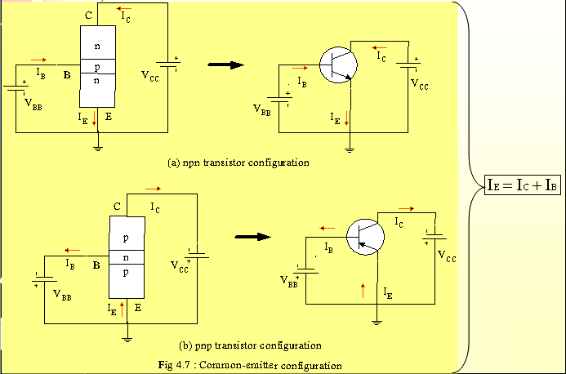
Proper Biasing common-emitter configuration in active region

Slide 21
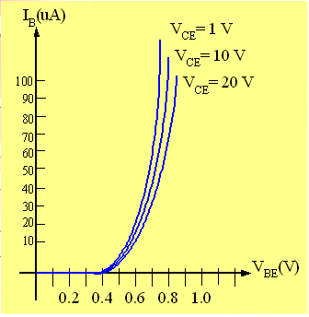
I_{B} is microamperes compared to miliamperes of I_{C}.
I_{B} will flow when V_{BE} > 0.7V
for silicon and 0.3V for germanium
Before this value I_{B} is very small and no I_{B}.
Base-emitter junction is forward bias
Increasing V_{CE} will reduce I_{B}
for different values.
Input characteristics for a
common-emitter NPN transistor

Slide 22
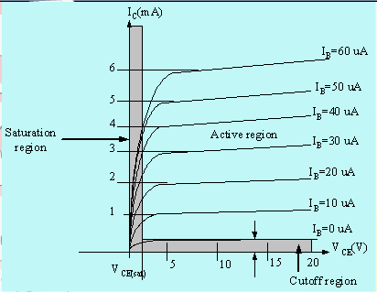
Output characteristics for a
common-emitter npn transistor
For small V_{CE} (V_{CE} < V_{CESAT}, I_{C} increase linearly with increasing of V_{CE}
V_{CE} > V_{CESAT} I_{C} not totally depends on V_{CE} → constant I_{C}
I_{B}(uA) is very small compare to I_{C} (mA). Small increase in I_{B} cause big increase in I_{C}
I_{B}=0 A → I_{CEO} occur.
Noticing the value when I_{C}=0A. There is still some value of current flows.

Slide 23
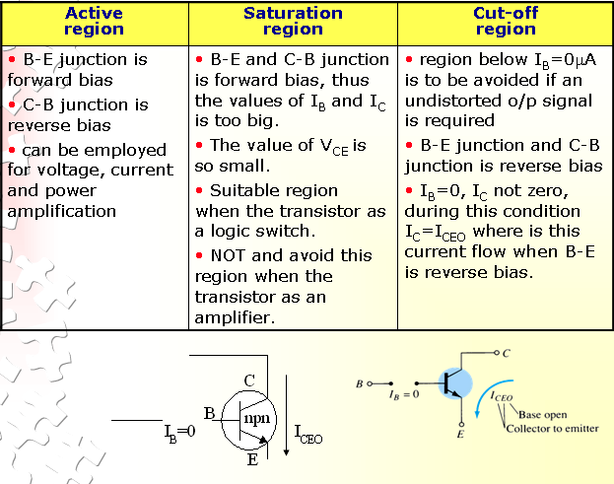

Slide 24
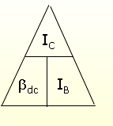
Beta (β) or amplification factor
The ratio of dc collector current (IC) to the dc base current (IB) is dc beta (βdc ) which is dc current gain where IC and IB are determined at a particular operating point, Q-point (quiescent point).
It’s define by the following equation:
30 < βdc < 300 → 2N3904
On data sheet, β_{dc}=h_{FE} with h is derived from ac hybrid equivalent cct. FE are derived from forward-current amplification and common-emitter configuration respectively.

Slide 25
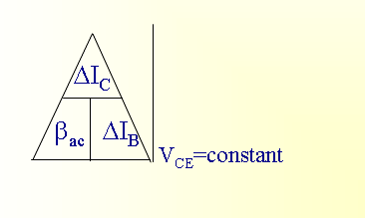
For ac conditions an ac beta has been defined as the changes of collector current (I_{C}) compared to the changes of base current (I_{B}) where I_{C} and I_{B} are determined at operating point.
On data sheet, β_{ac}=h_{fe}
It can defined by the following equation:

Slide 26
Example
From output characteristics of common
emitter configuration, find β_{ac} and β_{dc} with an
Operating point at I_{B}=25 μA and V_{CE} =7.5V.

Slide 27
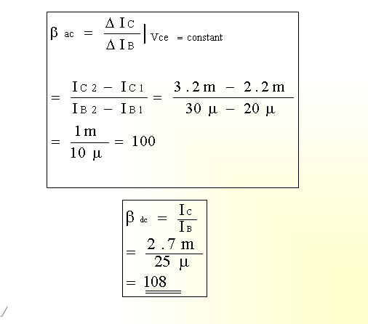
Solution:

Slide 28
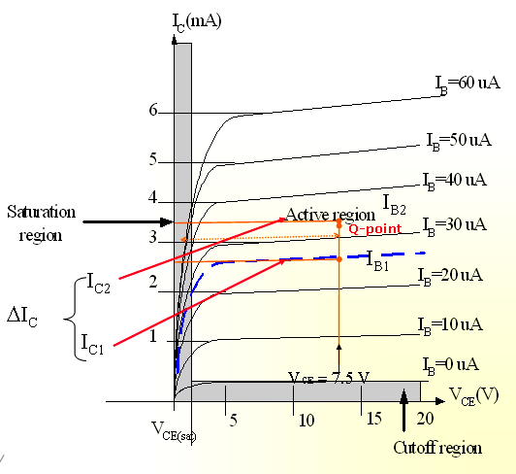

Slide 29
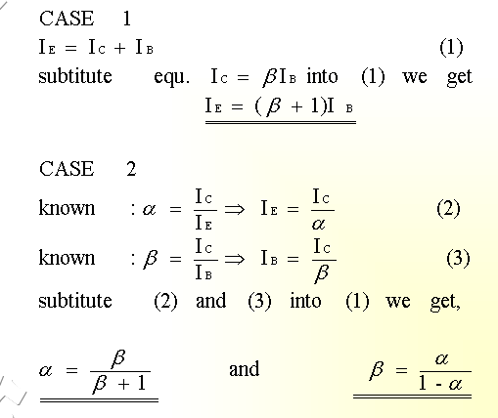
Relationship analysis between α and β

Slide 30
Common – Collector Configuration
Also called emitter-follower (EF).
It is called common-emitter configuration since both the
signal source and the load share the collector terminal as a common connection point.
The output voltage is obtained at emitter terminal.
The input characteristic of common-collector configuration is similar with common-emitter. configuration.
Common-collector circuit configuration is provided with the load resistor connected from emitter to ground.
It is used primarily for impedance-matching purpose since it has high input impedance and low output impedance.

Slide 31
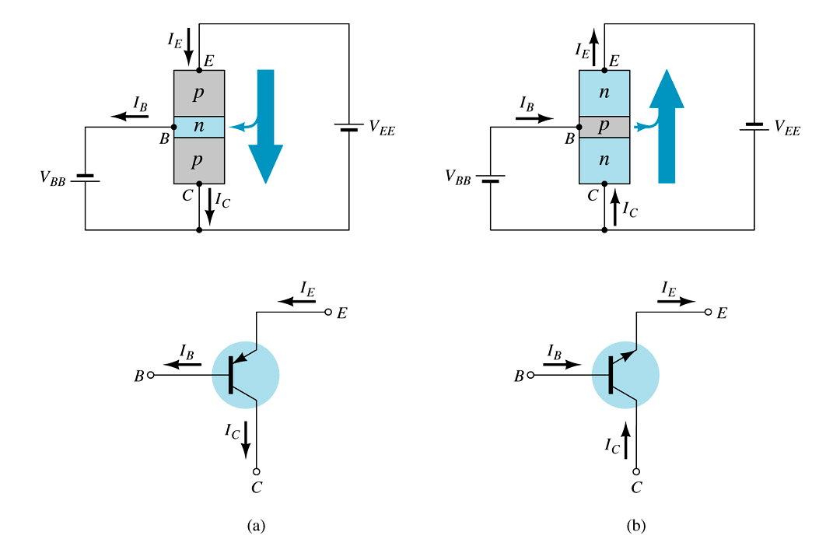
Notation and symbols used with the common-collector configuration:
(a) pnp transistor ; (b) npn transistor.

Slide 32
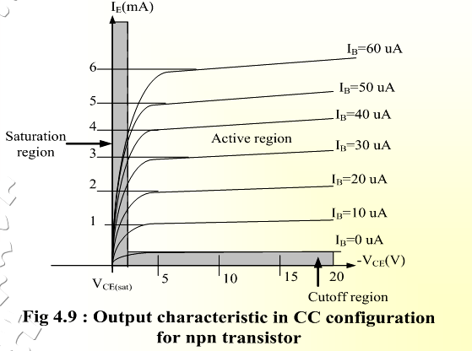
For the common-collector configuration, the output characteristics are a plot of I_{E} vs V_{CE} for a range of values of I_{B}.

Slide 33
Limits of Operation
Many BJT transistor used as an amplifier. Thus it is
important to notice the limits of operations.
At least 3 maximum values is mentioned in data sheet.
There are:
a) Maximum power dissipation at collector: P_{Cmax} or P_{D}
b) Maximum collector-emitter voltage: V_{CEmax} sometimes named as V_{BR(CEO}) or V_{CEO}.
c) Maximum collector current: ICmax
There are few rules that need to be followed for BJT
transistor used as an amplifier. The rules are:
i) transistor need to be operate in active region!
ii) I_{C} < I_{Cmax}
ii) P_{C} < P_{Cmax}

Slide 34
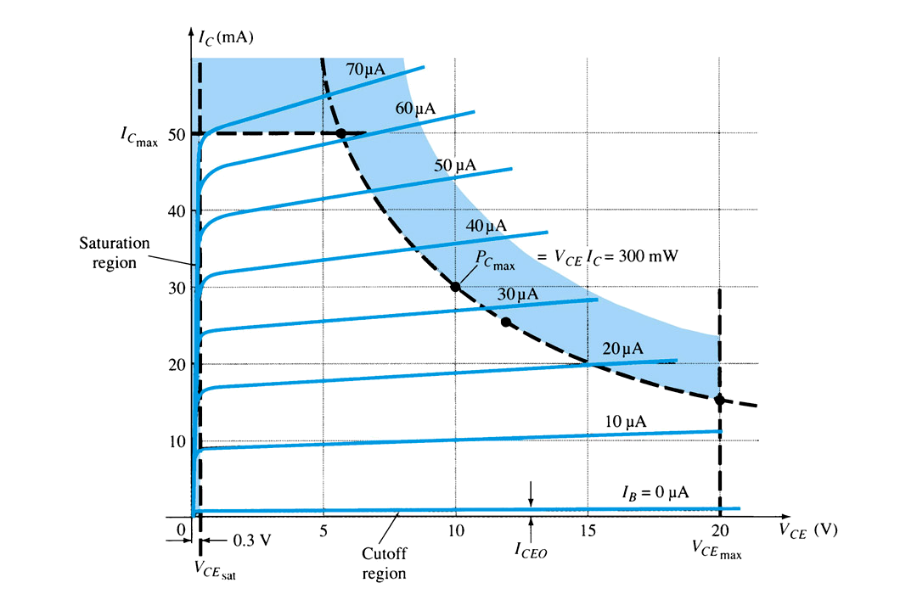
Note: V_{CE} is at maximum and I_{C} is at minimum (I_{Cmax}=I_{CEO}) in the cutoff region. I_{C} is at maximum and V_{CE} is at minimum
(V_{CE} max = V_{CEsat} = V_{CEO}) in the saturation region. The transistor operates in the active region between saturation and cutoff.

Slide 35
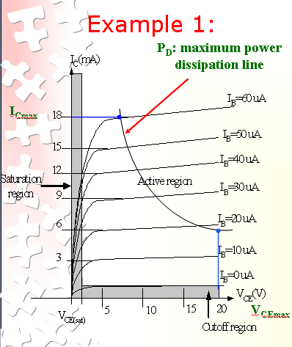
Refer to the fig.
Step1:
The maximum collector
power dissipation,
P_{D}=I_{Cmax} x V_{CEmax} (1)
= 18m x 20 = 360 mW
Step 2:
At any point on the characteristics the product of and must be equal to 360 mW.
Ex. 1. If choose I_{Cmax}= 5 mA, subtitute into the (1), we get
V_{CEmax}I_{Cmax}= 360 mW
V_{CEmax}(5 m)=360/5=7.2 V
Ex.2. If choose V_{CEmax}=18 V, subtitute into (1), we get
V_{CEmax}I_{Cmax}= 360 mW
(10) I_{Cmax}=360m/18=20 mA

Slide 36
Derating P_{Dmax}
P_{Dmax} is usually specified at 25°C.
The higher temperature goes, the less is P_{Dmax}
Example;
  A derating factor of 2mW/°C indicates the power dissipation is reduced 2mW each degree centigrade increase of temperature.

Slide 37
Example
Transistor 2N3904 used in the circuit with
V_{CE}=20 V. This circuit used at temperature
125⁰C. Calculate the new maximum I_{C}.
Transistor 2N3904 have maximum power
dissipation is 625 mW. Derating factor is
5mW/0C.

Slide 38
Solution
Step 1:
Temperature increase : 125^{0C} – 25⁰C = 100⁰C
Step 2:
Derate transistor : 5 mW/⁰C x 100⁰C = 500 mW
Step 3:
Maximum power dissipation at 125⁰C = 625 mW–500 mW=125 mW.
Step 4:
Thus I_{Cmax} = P_{Cmax} / V_{CE}=125m/20 = 6.25 mA.
Step 5:
Draw the new line of power dissipation at 125⁰C .

Slide 39
Example
The parameters of transistor 2N3055 as follows:
- Maximum power dissipation @ 250C=115 W
- Derate factor=0.66 mW/⁰C.
This transistor used at temperature 78⁰C.
Find the new maximum value of power dissipation.
Find the set of new maximum of I_{C} if V_{CE}=10V,
20V and 40 V.

Slide 40
Solution
Step 1:
Temperature increase : 78⁰C – 25⁰C = 53⁰C
Step 2:
Derate transistor : 0.66mW/⁰C x 53⁰C = 35 mW
Step 3:
Maximum power dissipation at 78⁰C = 115W– 35W=80 mW.
Step 4:
I_{Cmax} = P_{Cmax} / V_{CE}=80m/10 = 8 mA (point C)
I_{Cmax} = P_{Cmax} / V_{CE}=80m/20 = 4 mA. (point B)
I_{Cmax} = P_{Cmax} / V_{CE}=80m/40 = 2 mA (point A)

Slide 41
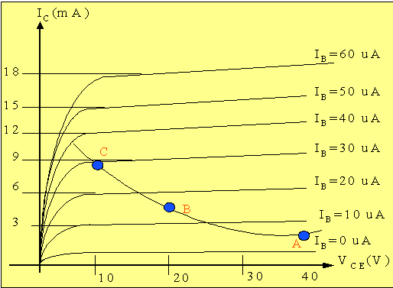
Step 5:
Draw the new line of power dissipation at 78⁰C .

Slide 42
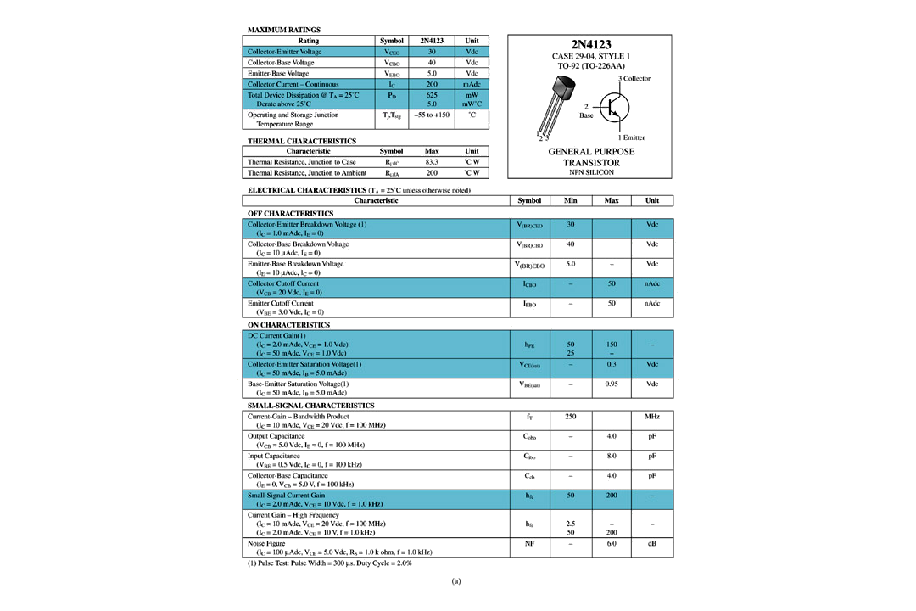
Transistor Specification Sheet

Slide 43
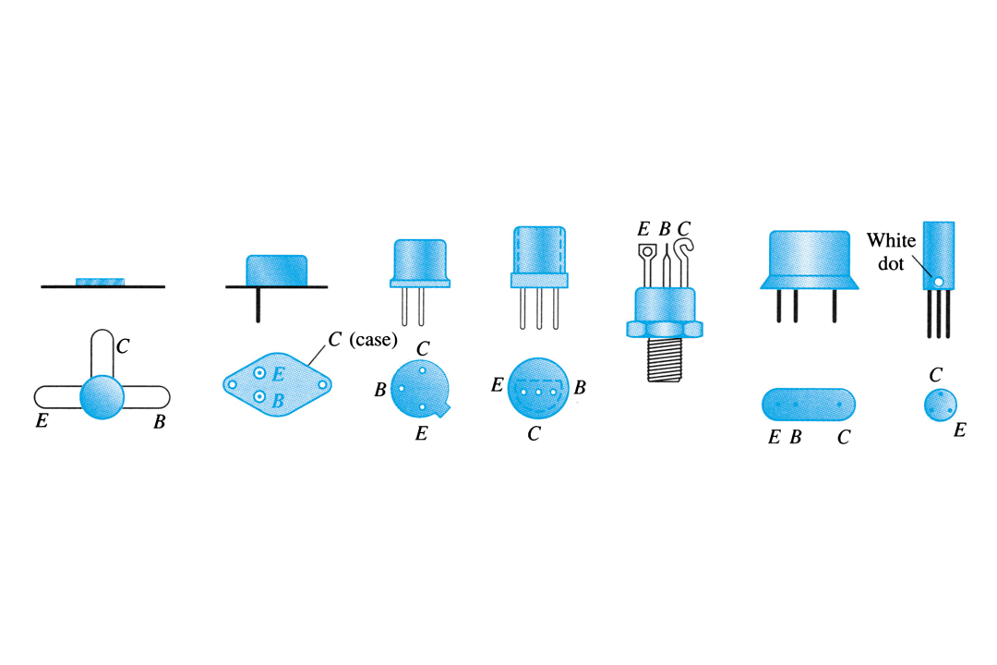
Transistor Terminal Identification

Slide 44
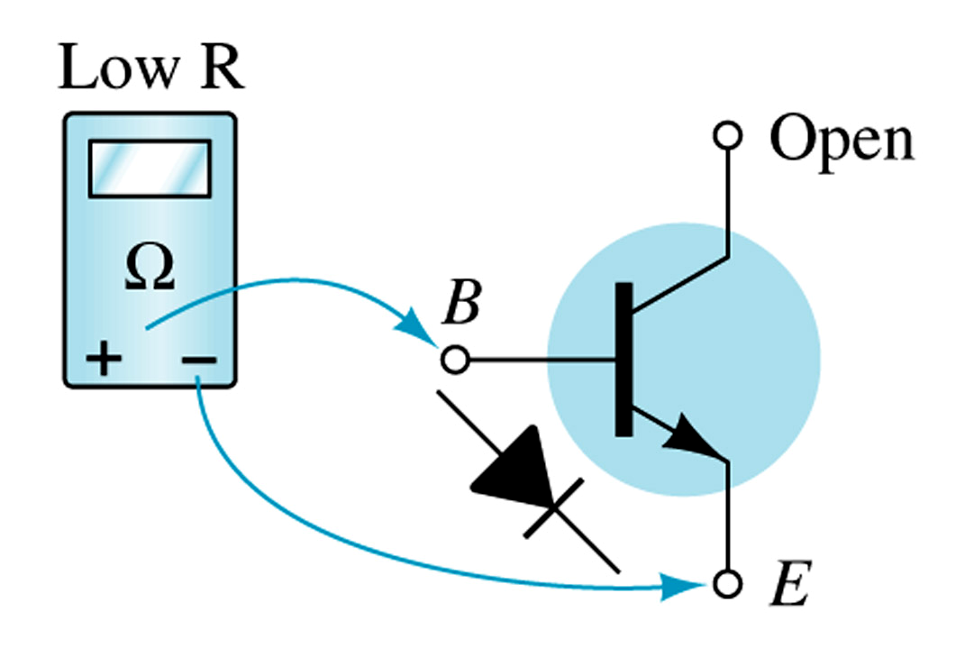
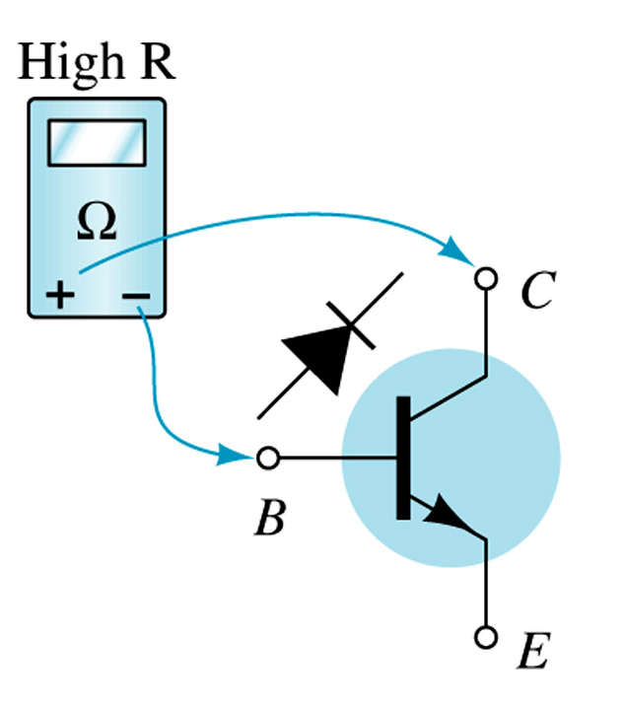
Transistor Testing
1. Curve Tracer
Provides a graph of the characteristic curves.
2. DMM
Some DMM’s will measure βDC or HFE.
3. Ohmmeter

